Slide 1




The IPACS model A simulation tool for complex care pathways 22nd November 2022
Feel free to introduce yourself in the chat box!
Dr Paul Forte
Dr Alison Harper
Dr Zehra Ӧnen Dumlu
IPACS Project Team

Slide 2
Learning Objectives
Introduction to the IPACS complex care pathways simulation model and its operational context
Hands-on experience of the IPACS model
Considerations and experience of embedding the model with local stakeholders

Slide 3
Welcome! Our agenda…

Slide 4

Improving Patient flow between Acute, Community and Social care (IPACS) project
Strategic
Support decisions on capacity allocation along complex discharge pathways in terms of total costs, patient experience, and patient outcomes
Operational
To provide easy-to-use, open-source, software tools for analysts to support process and capacity decision making
Cultural
For analysts: improve awareness and familiarity of advanced analytics solutions
For decision makers: highlight the value of (more) sophisticated modelling approaches and demonstrate the importance of system-wide working
Notes:
This project is about improving Patient flow between Acute, Community and Social care (IPACS) . On a strategic level we aim to support decisions on capacity allocation along complex discharge pathways in terms of total costs, patient experience, and patient outcomes.
On an operational level, we want to provide easy-to-use, open-source, software tools for analysts to support process and capacity decision making
On the cultural level we would like to improve awareness and familiarity of advanced analytics solutions for analysts and for leaders, we would like to highlight the value of (more) sophisticated modelling approaches and demonstrate the importance of system-wide working.

Slide 5
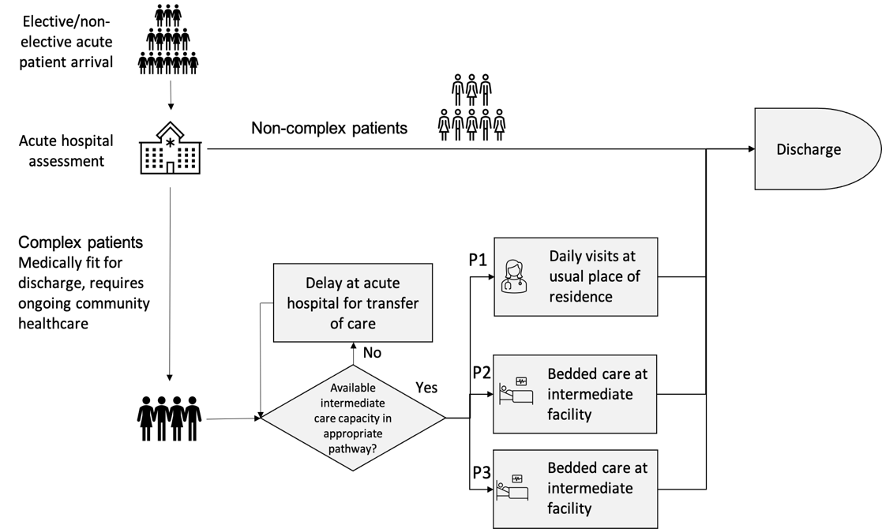
D2A: Complex care pathways
Discharge
to home (potential long-term support)
Admission
to hospital
Discharge from hospital:
potential delay if no capacity
in community pathways
Admission to complex care
pathways
Notes:
Only translate title and text in blue boxes: leave rest in English (or only translate if there’s time to; I wouldn’t worry about it). My intention is to animate the boxes one at a time as ai talk through the slide

Slide 6
Model variants
Bedded care
Care is provided in community hospital or care home beds
Length of Stay is variable
Each admitted patient consumes one service channel (bed) from admission to discharge
There are a fixed number of service channels (bed capacity)
Visits-based care
Care is provided at the patient’s own home through daily visits
Length of stay is variable
Each patient ‘consumes’ a different (reducing) number of daily home visits over their LoS
Capacity (max daily home visits) cannot be exceeded
The IPACS model addresses both of these modes of care

Slide 7
Deterministic vs Stochastic methods
For patient flow pathway modelling, health services (still) typically rely on simple spreadsheet ‘tools’ using average arrival rates and LoS
We know that planning by averages can lead to substantial under-estimation of required capacity
Stochastic methods can provide much more reliable results by capturing variability in the input parameters of the model
We have developed a purpose-built, easy-to-use, open-source simulation tool coded in R

Slide 8

Input Parameters
Time horizon (e.g., 6 months, 1 year)
Initial occupancy by locality, for each pathway
Initial queue in the acute by locality, for each pathway
medically fit for discharge, ‘no criteria to reside’ (NCTR)
Capacity by locality, for each pathway
Daily demand rate - Poisson arrivals
Initial and final number of visits per patient per day for visits-based care (P1)
Mean/median LoS for bedded care (P2 and P3)
Output Report
Routine report in Microsoft Word generated via Rmarkdown
Summary of inputs
For each locality and each care pathway: a set of plots which display all combinations of scenarios for:
Number of patients in service - the number of patients estimated to be utilising the service given service capacity;
Number awaiting service - the number of patients estimated to be delayed in the acute sector awaiting a D2A pathway;
Mean days delayed - the mean number of days a patient is delayed in the acute sector.
Costs - total system cost (acute delay cost + community service cost)
IPACS Simulation tool

Slide 9
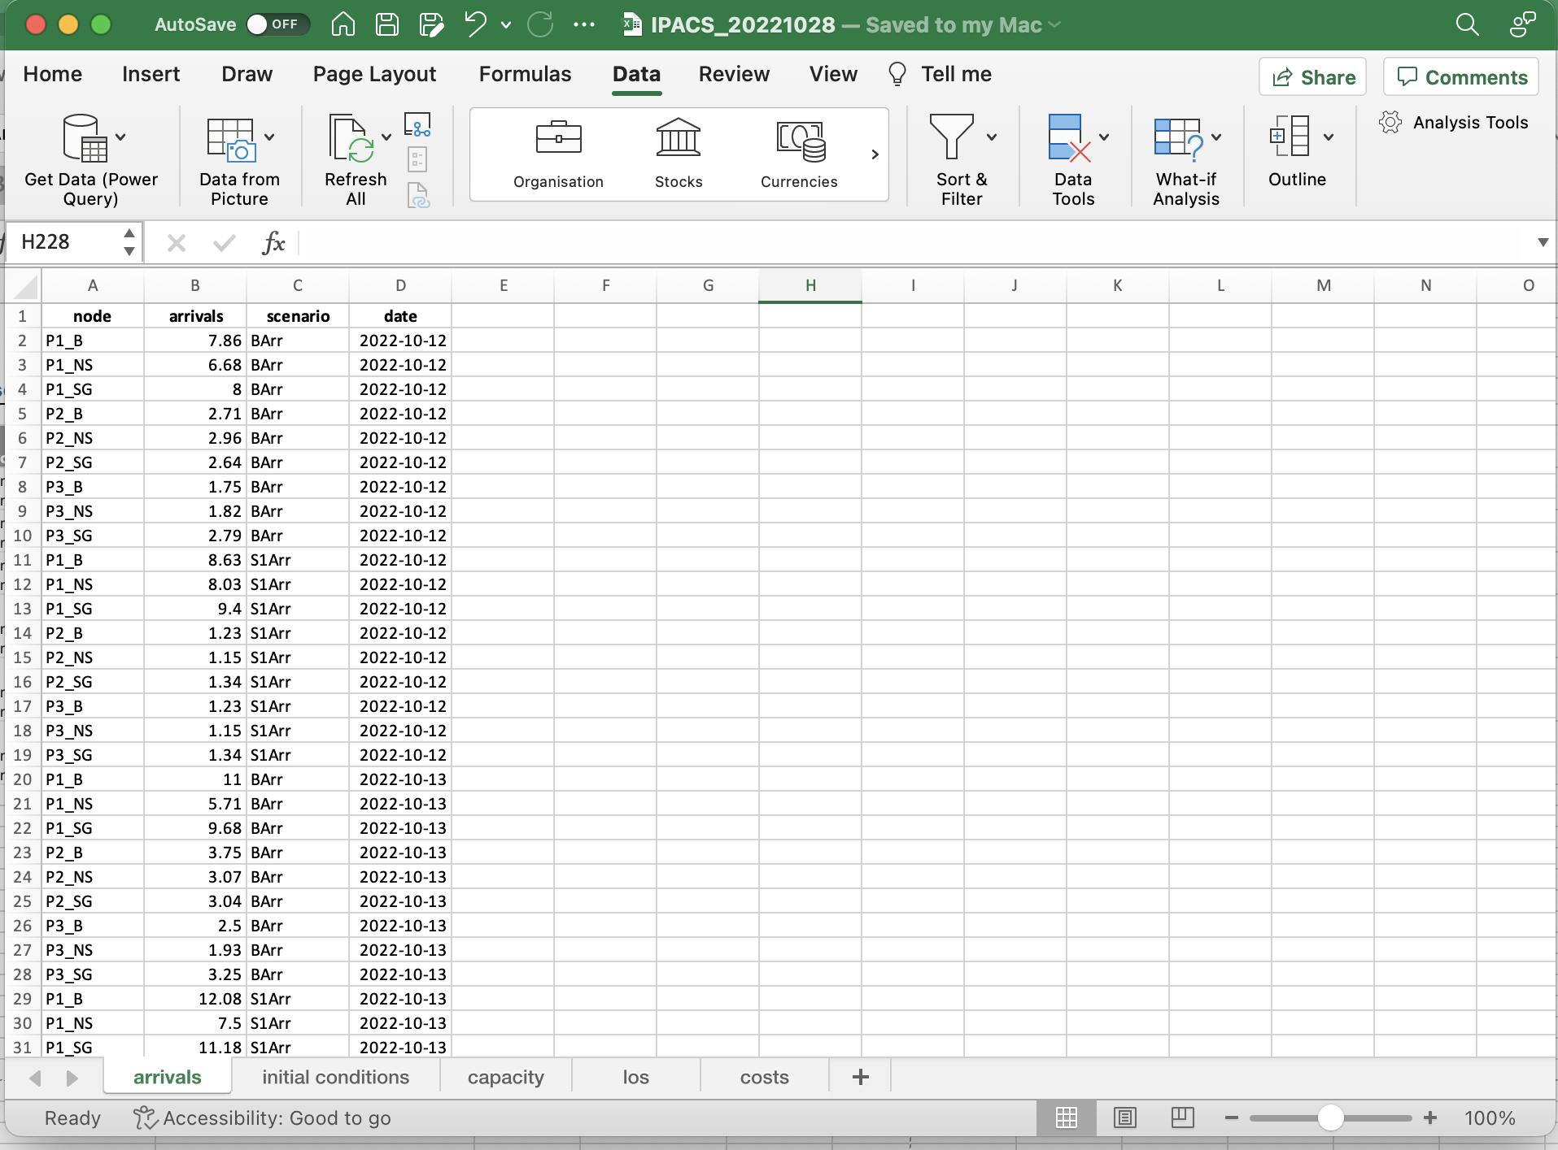
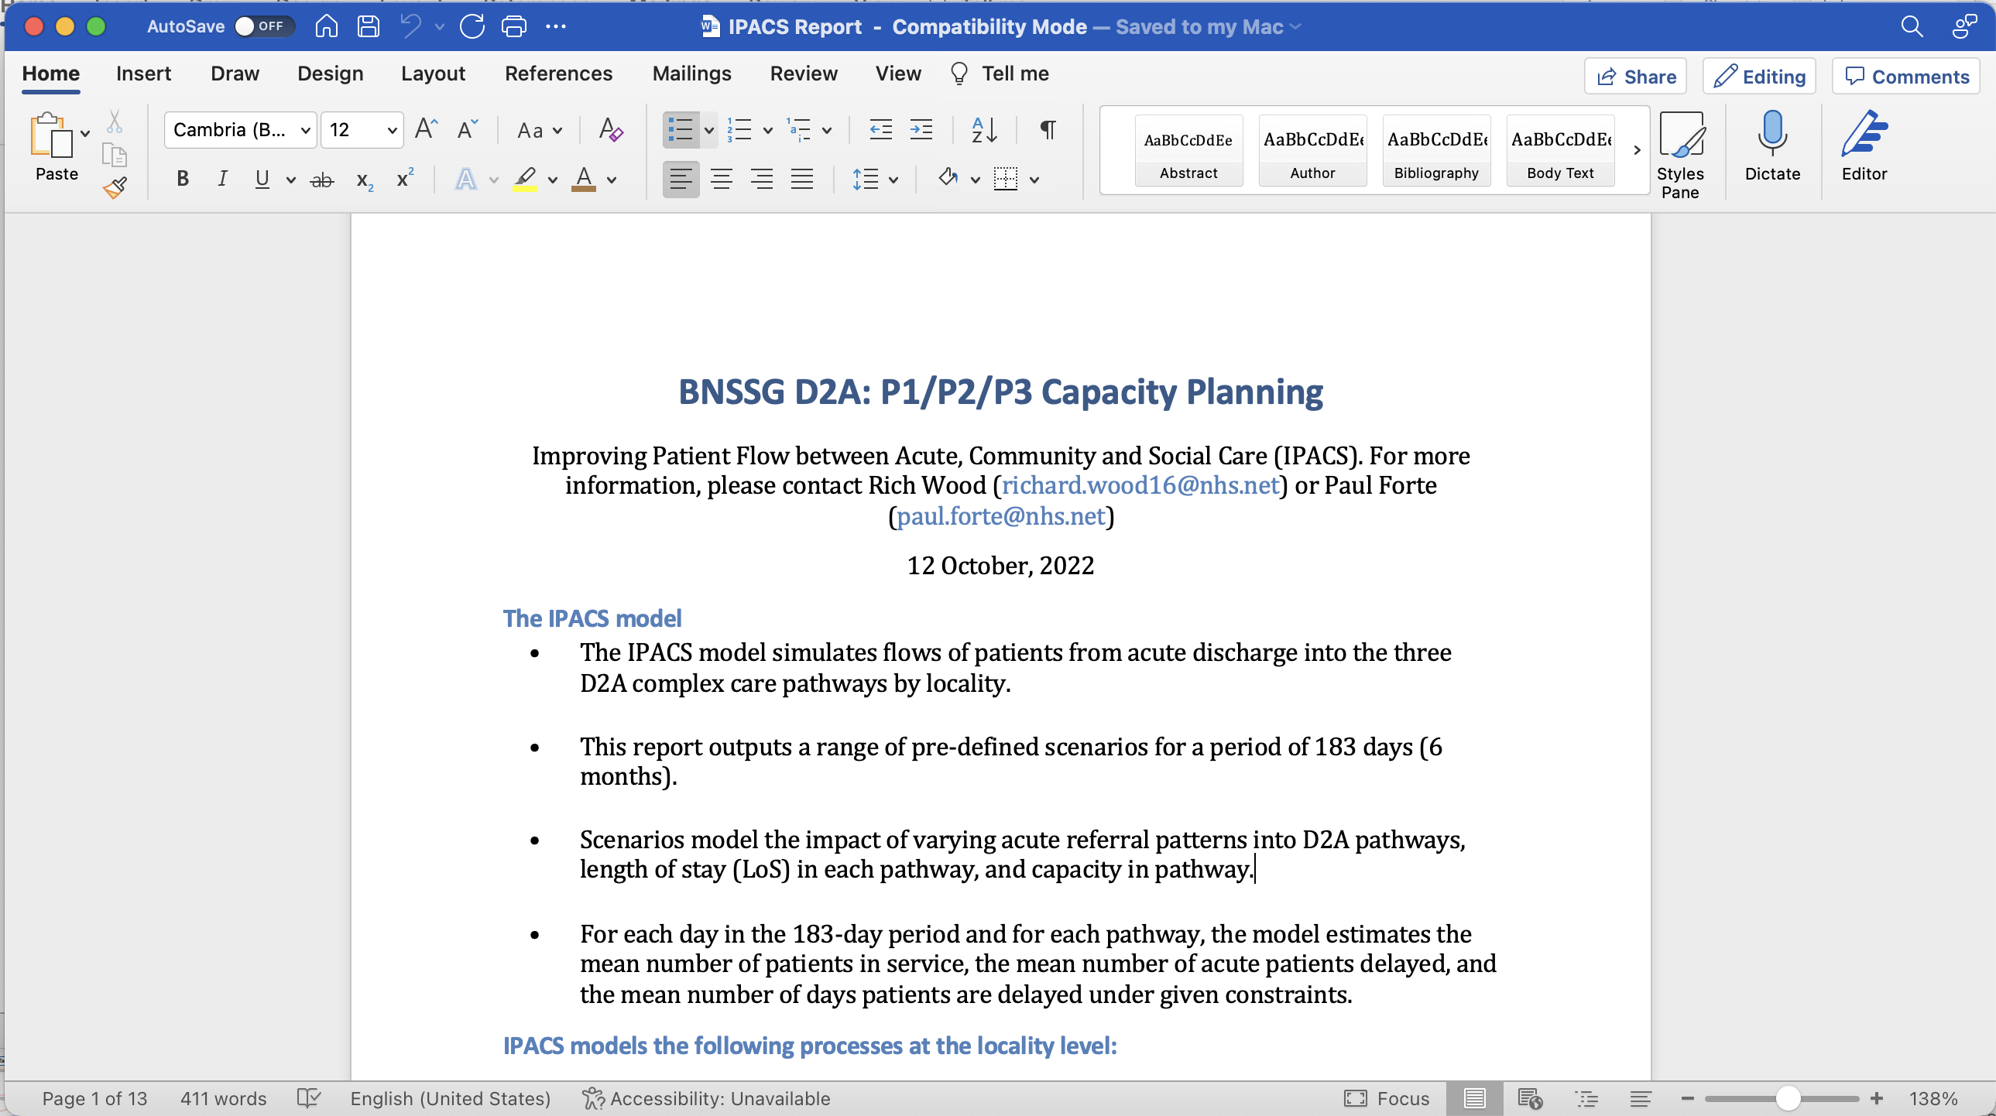
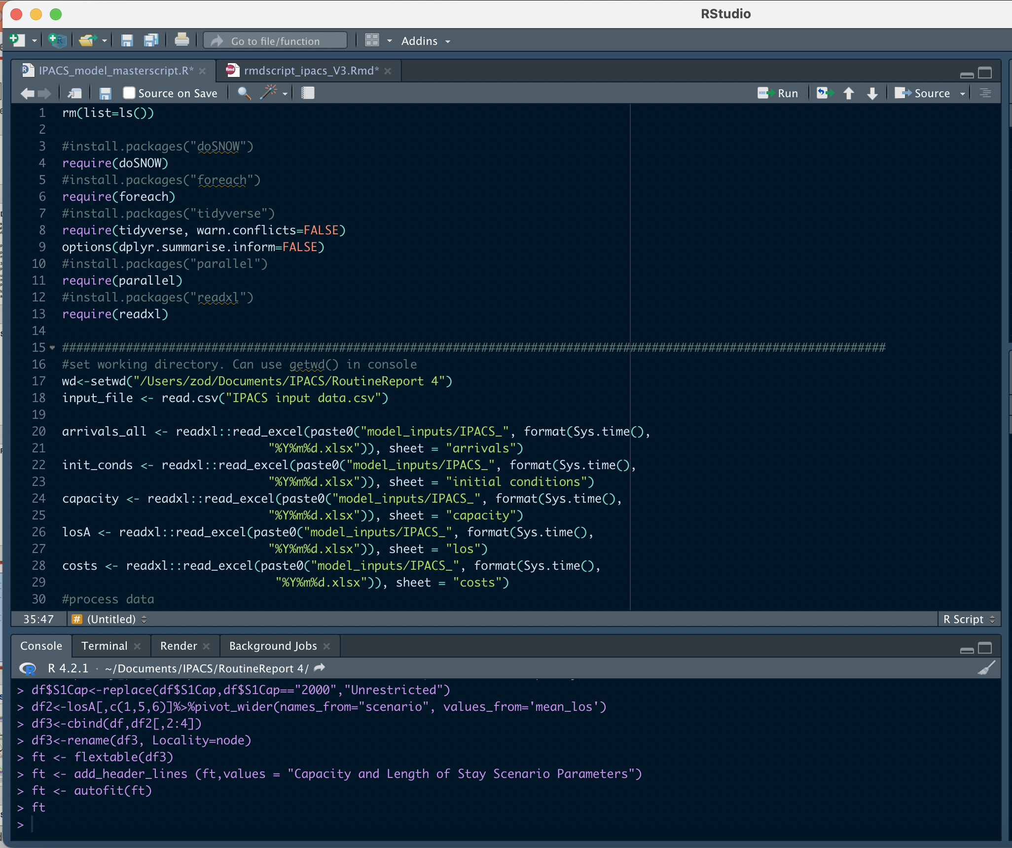
Input Parameters
Output Report
IPACS Simulation tool

Slide 10
Over to you – Exercise 1
Zehra will step you through the model, explaining its structure and data inputs via 2 illustrative hands-on exercises. We’d like you to follow along for yourselves, copying the steps using the version of the model you have downloaded.
Once everyone is happy that they are up and running, there are a few simple questions that we’ll leave you to have a go at yourselves for 10 minutes or so.
We’ll be around to answer questions/ help out and, at the end of that, we’ll run through some answers with you.

Slide 11
Exercise 1a)
Step 1: Download the IPACS Exercise 1a folder.
Step 2: Launch ‘Rstudio’.
Step 3: Open the file: IPACS_model_masterscript_exercise1a.R.
Step 4: Set the directory for your input files:
In the console window (bottom left window) set the ‘working directory’. This enables the model to find the folder where your data files are held.
To do this navigate through the folder where you downloaded IPACS Exercise 1a, right-click on Settings wheel and click on ‘Set as working directory’
Copy the output produced by this command to “setwd(“C:/Users…”)” in the script window (top left window).

Slide 12
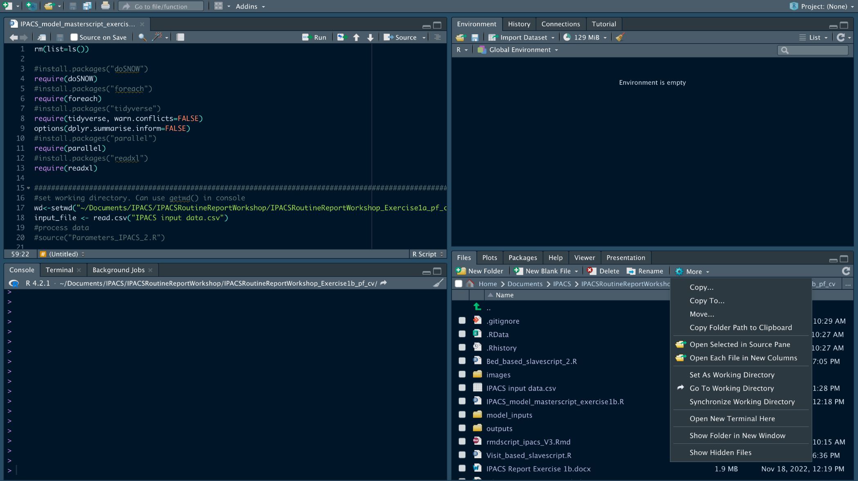

Slide 13
Exercise 1a)
Step 5: Run the IPACS model
Run the script Code->Run Region-> Run All (or use the shortcuts Ctrl + Alt + R (Windows users), or Cmd + option + R(Mac Users)).
Step 6: Results
Check the report IPACS Report Exercise 1a.docx in the IPACS Exercise 1a folder. You can also check the .csv files in outputs folder.

Slide 14
Exercise 1b)
Step 1: Download the IPACS Exercise 1b folder.
Step 2: Open the IPACS_20221122_exercise1b.xlsx Excel file.
Step 3: Now, imagine you would like to add a new scenario where you increase the capacity for all pathways and localities by 10%.
How would you do that? (Hint: You need to add new rows in the capacity sheet. Call the new scenario “S1Cap”).
Enter the values (you can also use a formula).
Save the document and close it.

Slide 15
Exercise 1b)
Step 4: Open the file: IPACS_model_masterscript_exercise1b.R.
Step 5: Set the directory for your input files:
In the console window (bottom left window) set the ‘working directory’. This enables the model to find the folder where your data files are held.
To do this navigate through the folder where you downloaded IPACS Exercise 1a, right-click on Settings wheel and click on ‘Set as working directory’
Copy the output produced by this command to “setwd(“C:/Users…”)” in the script window (top left window).
Step 6: Run the IPACS model
Run the script Code->Run Region-> Run All (or use the shortcuts Ctrl + Alt + R (Windows users), or Cmd + option + R(Mac Users)).
Step 7: Results
Check the report IPACS Report Exercise 1b.docx in the IPACS Exercise 1a folder. You can also check the .csv files in outputs folder.

Slide 16
Feedback – session 1
You’ve now been taken through the model and had an opportunity to try if out for yourselves… how did you get on?
Your initial impressions of the IPACS model…
Relevance?
Ease of use?
Any areas of confusion to clear up?

Slide 17

Take 10…
10-minute break

Slide 18
IPACS - model implementation
In this part of the workshop we’ll focus more on this aspect of the IPACS model including:
some general model implementation considerations
our experience of working in BNSSG
We’ll then proceed to Exercise 2 where we’ll allocate you to small groups to work through jointly on an exercise.
After that we’ll finish with a plenary feedback session to round off the workshop.

Slide 19
An embedding strategy for models
Takes much more time than modellers usually like…
Technical competence & Capacity
Technical domain experience: simulation modelling/ coding expertise
Model validation and testing
‘Peer-approval’ from other analysts/ experts
Contextual Awareness
Correct identification of model requirements and system drivers
Contextual domain experience
Stakeholder liaison/ politics/ ‘reassurance’
Very important for establishing and maintaining credibility and confidence - quickly
Notes:
Translate full page (or at least main sense)

Slide 20
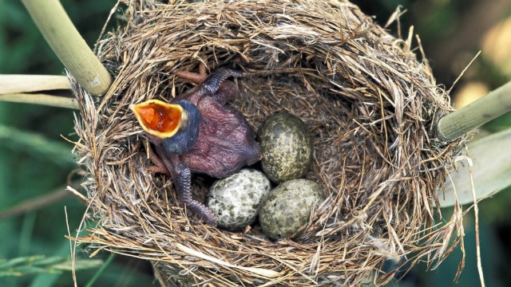
The IPACS ‘sticky strategy’
In BNSSG
obtaining senior management recognition and support; no single organisation in control
developing/ supporting local analytical capacity
in tune with local agenda
demonstrable ‘value-added’ to the management agenda
Further afield
Adjacent health & social care economies (Somerset; Bath, Swindon, Wiltshire)
DHSC – potential national dissemination perspective
Analyst networks
Notes:
Translate full page (or at least main sense)

Slide 21
IPACS in BNSSG…
Support input to business case for local system investment of £13m into D2A strategy
D2A Implementation Group – further scenario modelling support to end March 2023
Now looking to use the scenario modelling for longer term 2023/24 activity planning
Multi-organisational involvement: ICB, Community Health and the three Local Authorities including:
community health and social care professionals
operational and strategic management and finance

Slide 22
Over to you – exercise 2
Exercise 2 provides you with a fresh version of the model which will automatically read in your input files
From GitHub, download and save Exercise 2 files into a local folder
Open the Word document ‘Exercise 2 Instructions’
Your objective is to come up with a scenario which:
reduces both numbers of patients delayed and average queue waiting time
minimises costs
We’re keeping it simple; so you can only vary:
average length of stay by pathway and locality
pathway capacity by locality
(In this instance, you can’t vary patient arrival rates)

Slide 23

Workshop evaluation form
In the chat box you will find a link (or follow the QR code in this slide) to an evaluation form which we’d be grateful if you would take 5 minutes now to complete for us.
When you’re finished just click on the submit button at the bottom of the form.
We appreciate that you may have further comments or queries post-workshop. If so, please drop a line to Paul at paul.forte@nhs.net

Slide 24
Exercise 2: group feedback
Group feedbacks:
Why did you choose the values you did?
What might be involved in implementing any parameter value changes you have made?
Implications for timescale, health and social care resources?

Slide 25
Plenary: your reflections on…
IPACS model relevance – does it address pertinent local issues?
generalising the model - would it work in your area given its data requirements/ your local D2A setup?
what barriers might there be to its local use?
‘best thing/ worst thing’ about the model?

Slide 26
Thanks for attending - we hope you enjoyed the workshop!
You want to follow-up? paul.forte@nhs.net
Zehra, Alison and Paul

